Slide 1

Movie Recommendation System
Made by:
Agam Aggarwal(20csu203)

Slide 2
Topics Covered
Problem Statement
Background study
Objective of the project
Model explanation
Results
Future scope
Conclusion

Slide 3
Problem Description
Recommendation system is all about recommending the next content to its user.
The idea of this project is to use the given dataset and to recommend suggestions of similar movies
The suggestions of the movies will be based on the description of the movie or the genre of the names of movies provided the user.

Slide 4
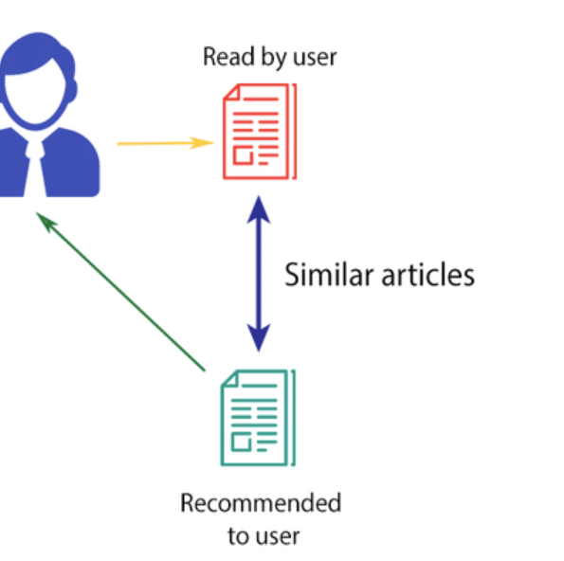
Background study
In a content-based recommendation system, the background knowledge of the products and customer information are taken into consideration
For example, consider a scenario in which a person goes to buy his favorite cake ‘X’. Unfortunately, cake ‘X’ has been sold out and as a result of this the shopkeeper recommends the person to buy cake ‘Y’ which is made up of ingredients similar to cake ‘X’.
The benefits of content-based filtering include the ability to recommend unrated goods, the simplicity of explaining an item's Content feature, and the requirement for only the concerned user's rating, not that of any other system user.

Slide 5
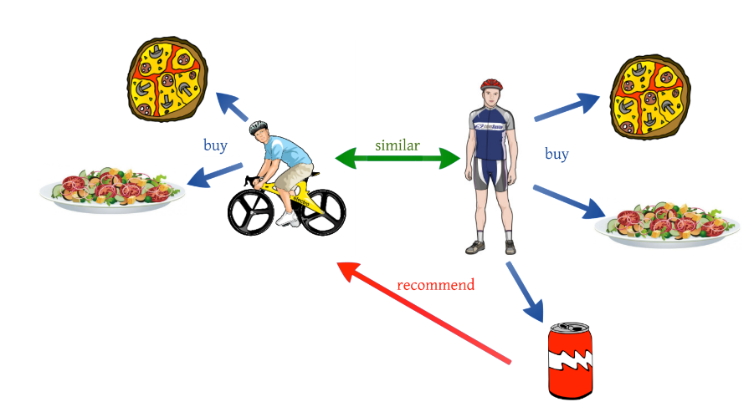
Background study
Collaborative filtering provides suggestions on similar products and recommendations based on the similar profiles of its users.
For example, consider A and B are two users who are watching movies online on a specific platform, both of them watched the A1 movie and then watched the B2 movie(at different times). Now user B has watched movie A2, so this movie will also be for A who hadn’t watched that movie yet.
There are mainly two types of collaborative filtering techniques Memory Based approach and the Model-Based approach. In Memory Based approach, the recommendation is done based on past activities, whereas in the model-based approach, some prediction will take place based on ratings, page viewing time, clicks, and so on.

Slide 6
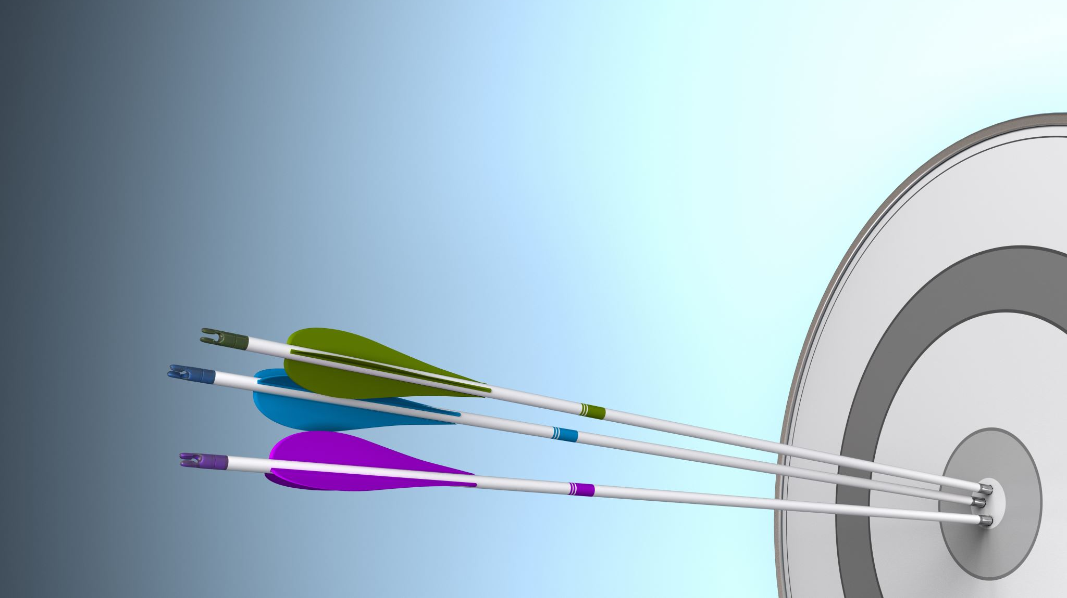
Objectives for the project
Increase in revenue
Customer Satisfaction
Personalization

Slide 7
DKKEts ataset Description
The dataset is chosen from Kaggle. It consists of two CSV files—"rating.csv" and "movies.csv”:
The movie dataset consists of the following attributes:
‘movieId’: It indicates the unique id provided to every movie in the dataset.
‘title’: It indicates the name and the year of release of every movie.
‘genres’: It indicates the genres present in each movie.
The rating dataset consists of the following attributes:
‘userId’: It indicates the id provided to every user in the dataset.
‘movieId’: It indicates the unique id provided to every movie in the dataset.
‘rating’: It indicates the rating given to the movies by the user on a scale of 1-5.
‘timestamp’: it is a sequence of characters or encoded information identifying when a certain event occurred

Slide 8
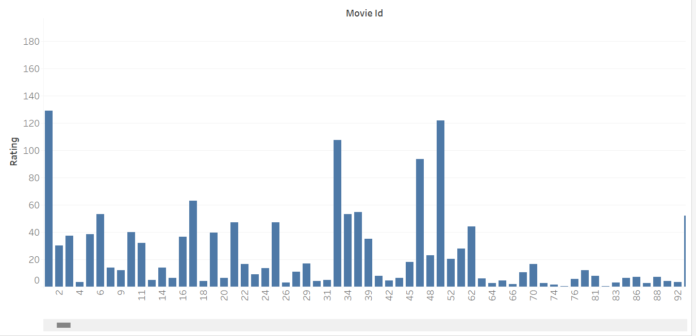
Data Visualization
Total number of ratings given to each movie
Here movies are represented by movieid

Slide 9

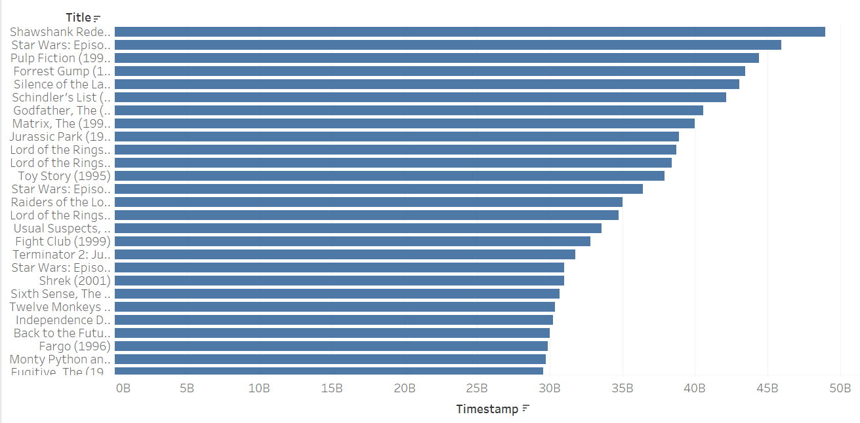

Data Visualization (Contd)
Movies with their timestamp ratings in decreasing order

Slide 10
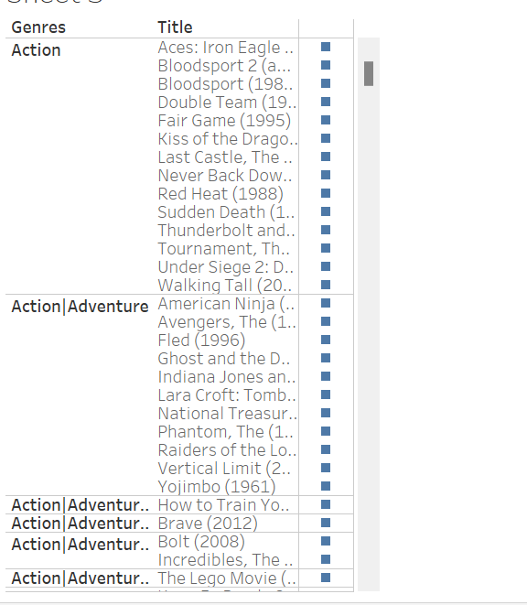
Movies Grouped on the basis of Genre
Here each movie is grouped or placed according to the genre format.

Slide 11
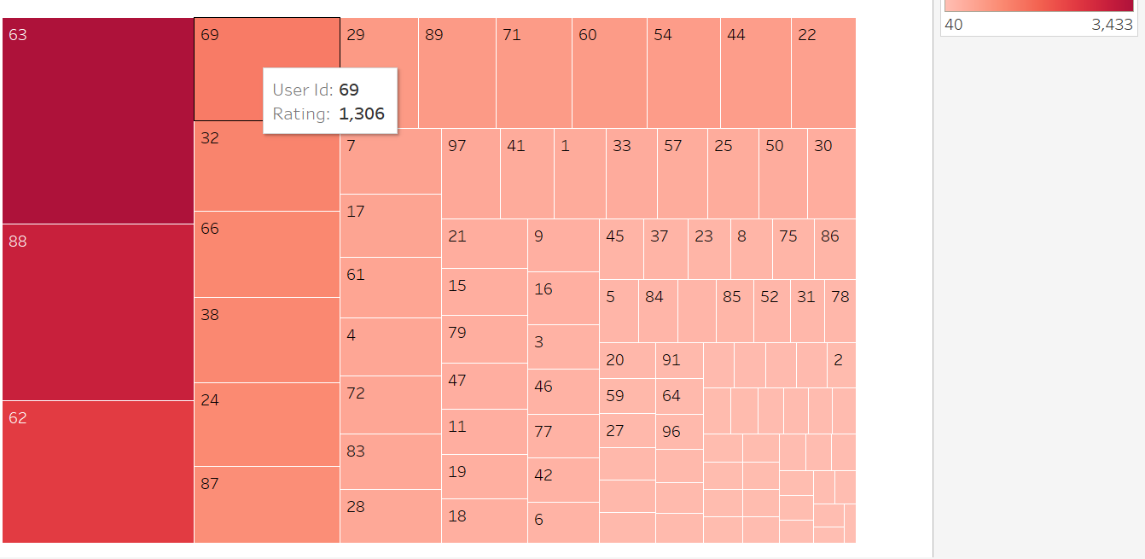
Data Visualization (Contd)
Total number of rating in given by the each user.
User is represented by user id

Slide 12
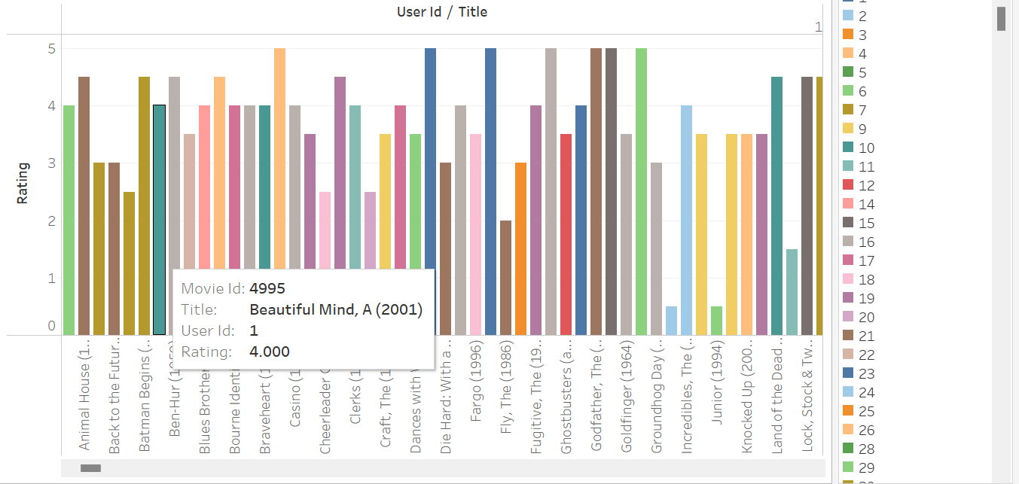
Data Visualization (Contd)
Rating is on a scale of 1 to 5
Movie name is represented in the x-axis.
Each color is representing the movie id

Slide 13
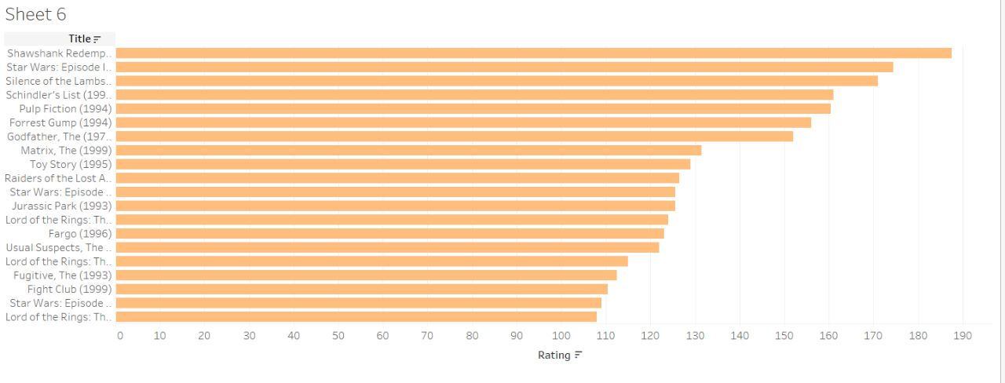
The visualization represents top 10 titles that
received Highest ratings based on filtering.

Slide 14
Model explanation
In content-based model
We have used the TF-IDF algorithm to the built content-based recommendation system
The TF-IDF(Term Frequency-Inverse Document Frequency (TF-IDF) ) score is the frequency of a word occurring in a document
We have also used a cosine similarity score to measure document similarity in text analysis.
Its significance in computing the final similarity score.
In the collaborative filtering model:
We have analysed the average rating based on the dataset
Then we generated a dataframe that consists of average rating and total ratings for each movie
We have used Pearson correlation to find the linear relationship between two movies.
It has been as a calculating score

Slide 15
Results Obtained
Recommendation system uses Data Science to cater to relevant and interesting recommendations for their users.
Recommendation system uses data analytics to find the right time to launch shows and ad campaigns to have maximum impact on the target audience.
This project aims to a content-based recommendation based on the genre of movies and collaborative filtering system of movies on the basis of ratings.
It will help in increasing the revenue of the company by an increase in the number of customers and helps with personal

Slide 16
Future scope of the project
Here are some possible areas of future scope for recommendation systems:
Context-Aware Recommendations: The future of recommendation systems lies in making them more personalized by incorporating contextual information, such as time, location, weather, etc.
Explainable Recommendations: In the future, recommendation systems can be designed to provide explanations for their recommendations, which can help users understand why a particular recommendation was made.
Multi-Objective Recommendations: Recommendation systems can be designed to optimize multiple objectives simultaneously, such as diversity, novelty, serendipity, and so on.
Hybrid Recommendations: There could be more advanced hybrid recommendation systems that can leverage different types of data, such as social media activity, user profiles, and product reviews, to provide more accurate and relevant recommendations.

Slide 17
Conclusion
In a nutshell, this project has explored different approaches to recommendation systems, including collaborative filtering and content-based filtering.
The study has shown that collaborative filtering algorithms are effective in recommending items based on user preferences and behaviour, while content-based filtering algorithms are useful for recommending items based on their features and attributes.
Moreover, hybrid methods that combine collaborative and content-based filtering can provide more accurate and diverse recommendations.

Slide 18


Slide 19


